Slide 1
Routines and Libraries

Slide 2
Reasons to Create a Routine
Avoid duplicating code
Documentation value (a simple abstraction)
Reduce or hide complexity
Hide required sequences
think of a hardware-specific initialization
Improve portability
Aid readability

Slide 3
Design at the Routine Level should revolve around the principle of cohesion – a routine's operations should be related
Functional Cohesion is ideal – the routine performs only one operation
Less ideal are:
Sequential Cohesion – steps in a routine must be performed in the specified order
Communicational Cohesion – uses the same data, but to different purposes
Temporal Cohesion – operations that happen at the same time

Slide 4


Slide 5
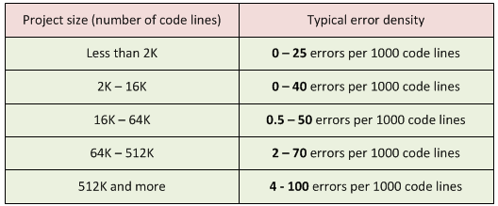
What is the best length for a routine?
Some people say 50-100 lines
IBM once required that no routine should exceed 50 lines
TRW limited them to 2 pages in printout
People have spent lots of time studying this
No consensus
Be careful if you exceed 150 lines

Slide 6
Good routines have well-designed parameter lists
List params consistently in different routines
Use "self-documenting" names for formal parameters
Don't pass unused parameters
Limit number of parameters
Document assumptions

Slide 7
3rd Party Libraries
The standard Java libraries fail to provide enough methods for manipulation of its core classes.
Many 3rd party libraries exist to provide extra methods or convenience methods
Goal is to do common tasks easily
Apache Commons is a popular one
Commons Lang - utilities for the java.lang API, such as String manipulation methods, basic numerical methods, etc.
Commons IO - utilities to assist with developing IO functionality
Log4j, Joda Time, etc.

Slide 8
3rd Party Libraries
Examples we will look at today:
Apache Commons Lang
https://commons.apache.org/proper/commons-lang/download_lang.cgi
Apache Commons IO
http://commons.apache.org/proper/commons-io/download_io.cgi
Download the binaries and unzip
You will find jar files
Download the source (optional)
To see implementation

Slide 9
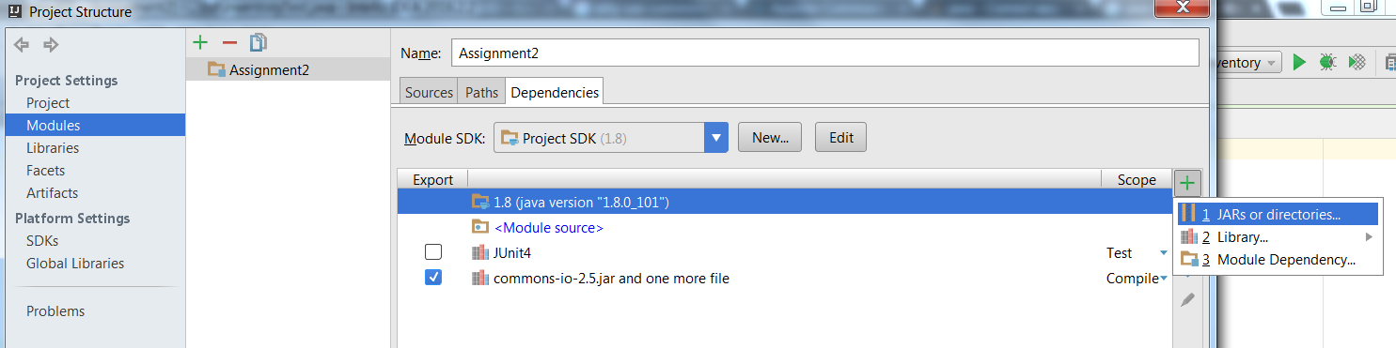
Adding 3rd Party Libraries to IntelliJ
1
Open IntelliJ then go to File -> Project Structures
2
3
4

Slide 10

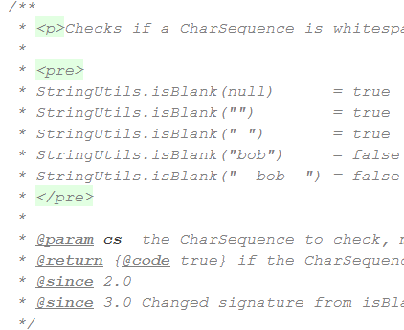
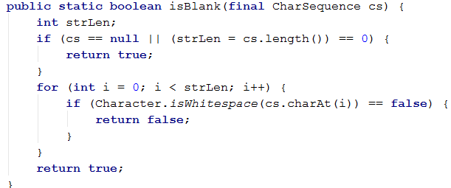
Example Uses of Common Lang
StringUtils Class

Slide 11
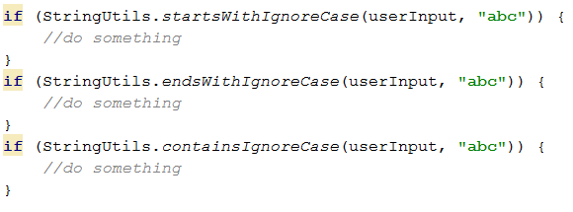
Example Uses of Common Lang
StringUtils Class
Not available in the standard java API
No need to reinvent the wheel
Use 3rd party library
Code is well tested and actively maintained

Slide 12


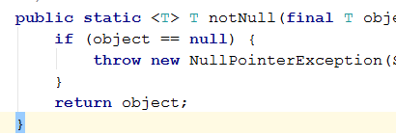

Many More in Common Lang
ArrayUtils
RandomStringUtils / RandomUtils
When would this be super useful?
Validate

Slide 13
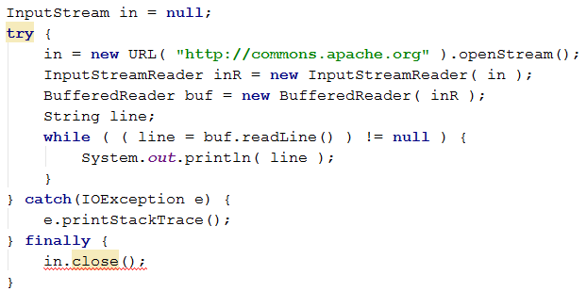
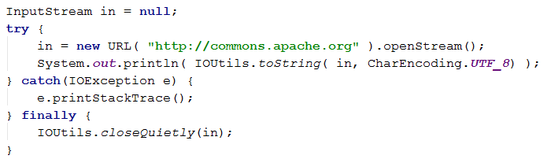
Example Uses of Common IO
VS

Slide 14
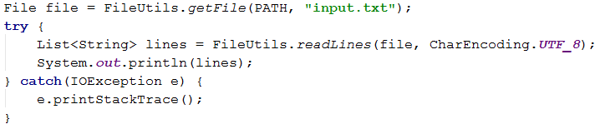
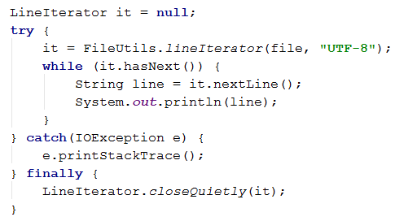
Working with Files

Slide 15
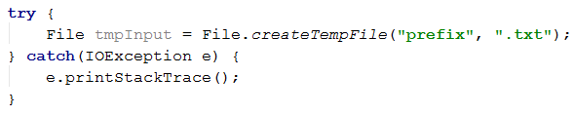
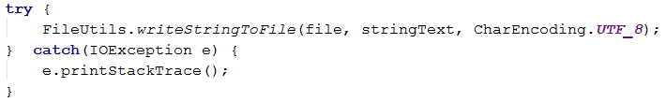
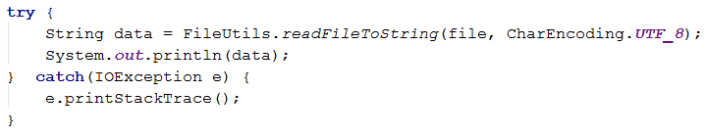
Working with Files
When would this be useful?

Slide 16
Popular 3rd Party Libraries
Apache Commons
Google Guava
SpringFramework.Util

